Slide 1
QF602: Derivatives
Lecture 6:
Volatility Smiles and Barrier Options

Slide 2
Implied Volatility, Smile and Surface
Recall implied volatility is the value of the constant volatility parameter such that the Black Scholes option formula produces the same price as the observable option price.
Volatility smile is a collection of those implied volatilities for different strikes with the same maturity.
Volatility surface is a collection of the volatility smiles with different maturities.
If Black Scholes’ constant volatility assumption were correct, then we should have the same value of implied volatility for any strike and maturity.

Slide 3
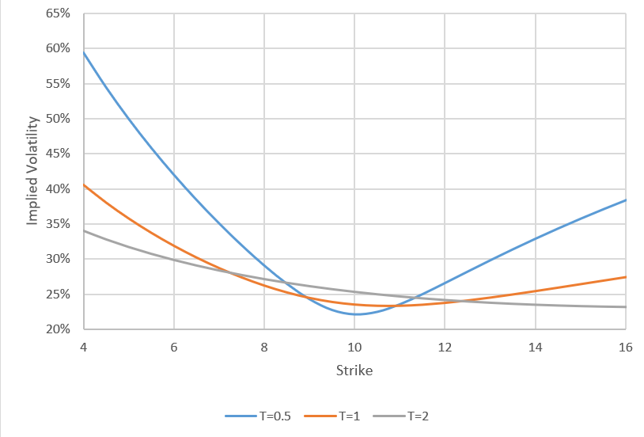
Implied Volatility Surface
The diagram below shows a typical volatility surface with maturity 0.5, 1 and 2 years.

Slide 4
Implied Volatility Surface
It does not mean Black Scholes is useless in practice. In fact, the notion of implied volatility is deeply rooted in all aspects in the derivatives industry.
One can view the Black Scholes closed-form option formula is nothing more than convert an option price to an implied volatility or reverses.
It is just a redefinition of price, like converting temperature from Fahrenheit to Celsius or bond price to bond yield.
If you graph bond price against time you get a useless cloud of points, but if you graph bond yield against time you get a yield curve. Similarly graphs of option price are useless, but a graph of implied volatility versus expiry and moneyness/strike gives a volatility surface.

Slide 5
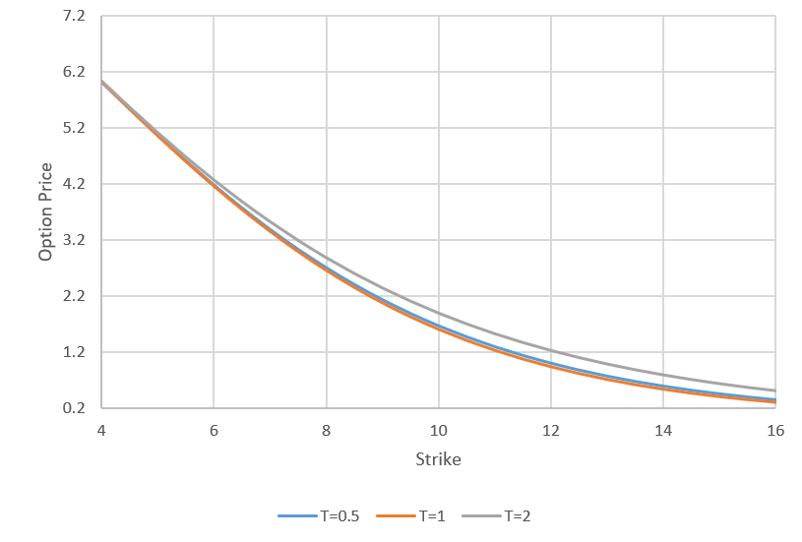
Option prices vs Strikes and Maturities
The diagram below shows the corresponding graph for option prices with different strikes and maturities. Not much intuitions from the graph.

Slide 6
Call Spreads with different models
The Black Scholes formula is a conversion between option price and implied volatility.
How about pricing a European payoff that depends on more than one strike?
We can use Breeden-Litzenberger formula if we have the corresponding implied volatilities.
Consider the following situation:
The underlying is a tradeable stock.
There is only one observable option price, which is ATM and with maturity T.
You are asked to price a call spread with maturity T.
You have Black, Bachelier and SLN models at your disposal.
What kind of prices will the three models give you?

Slide 7
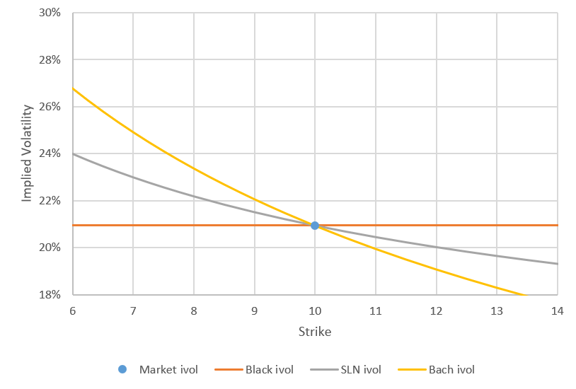
Call Spreads with different models
We calibrate all the three models to the ATM option price.
The shift parameter is a free parameter as the SLN model has 2 parameters and we only have one observable price to calibrate. We pick it such that it is somewhere between Back and Bachelier.

Slide 8
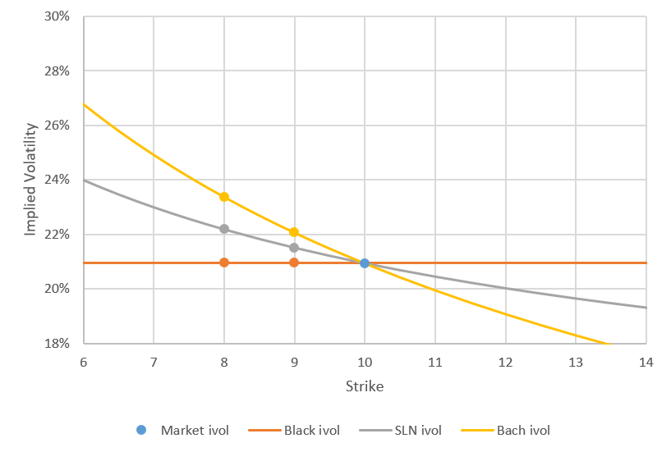
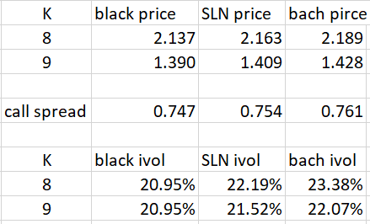
Call Spreads with different models
The forward price is 10, interest rate is 0, maturity is 1 year. The call spread is with strikes 8 and 9. To price the call spread, we only need the implied vols for each model at strike 8 and 9. We can see the call spread price is skew dependent.

Slide 9
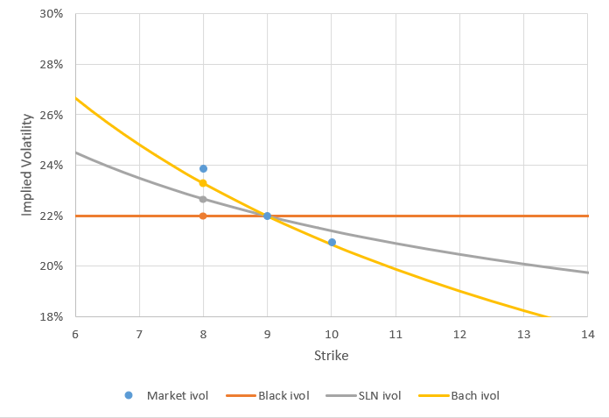
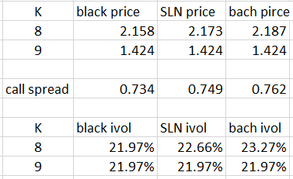
Call Spreads with different models
Now consider the case there are observable prices at strikes 8, 9 and 10. We calibrate all 3 models to the price at 9.
Notice that the dynamics of the SLN is between Black and Bachelier. We can see the market implied vol is “beyond the reach” of Bachelier. So there is no point trying to calibrate the shift parameter if we want to calibrate exactly to the price at 9.

Slide 10
Call Spreads with different models
We would like to have a consistent model that “know” about the skew information.
It suggests that we need a better model.

Slide 11
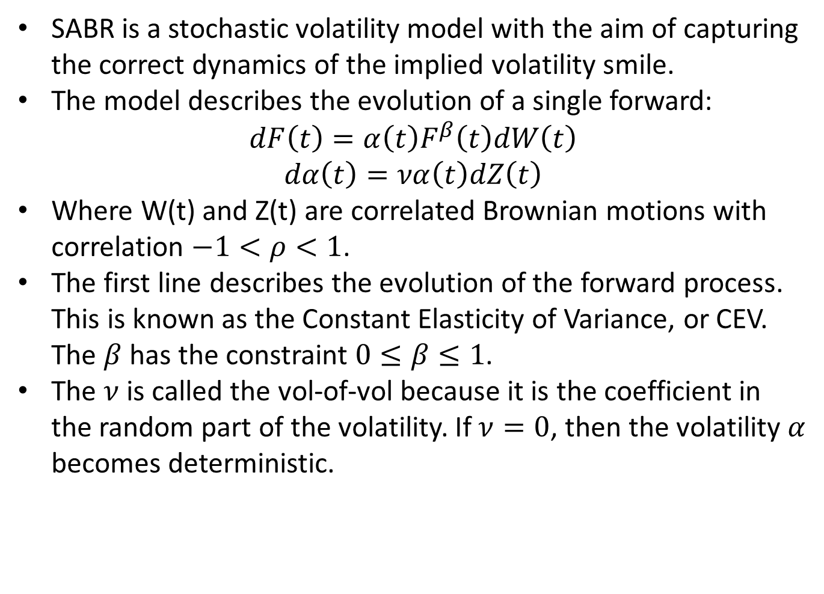
SABR
SABR is a stochastic volatility model with the aim of capturing the correct dynamics of the implied volatility smile.
The model describes the evolution of a single forward:
$$dF\left(t\right)=α\left(t\right)F^{β}\left(t\right)dW\left(t\right)$$
$$dα\left(t\right)=να\left(t\right)dZ\left(t\right)$$
Where W(t) and Z(t) are correlated Brownian motions with correlation $−1<ρ<1$.
The first line describes the evolution of the forward process. This is known as the Constant Elasticity of Variance, or CEV. The $β$ has the constraint $0≤β≤1$.
The $ν$ is called the vol-of-vol because it is the coefficient in the random part of the volatility. If $ν=0$, then the volatility $α$ becomes deterministic.

Slide 12
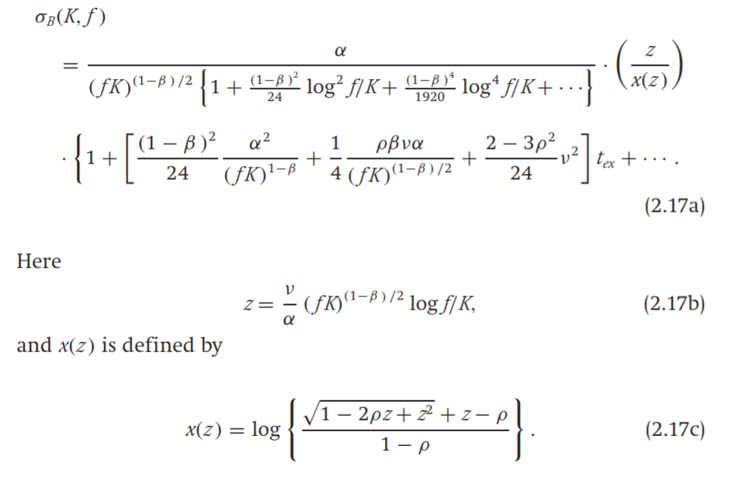
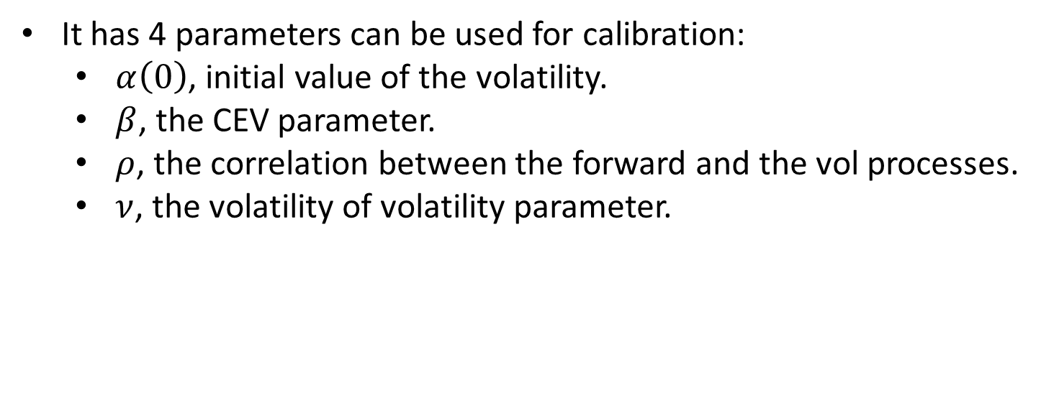
SABR
It has 4 parameters can be used for calibration:
$α\left(0\right)$, initial value of the volatility.
$β$, the CEV parameter.
$ρ$, the correlation between the forward and the vol processes.
$ν$, the volatility of volatility parameter.

Slide 13
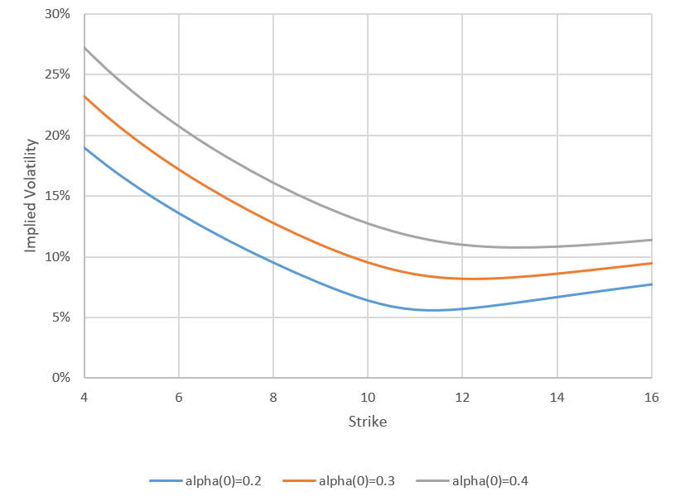
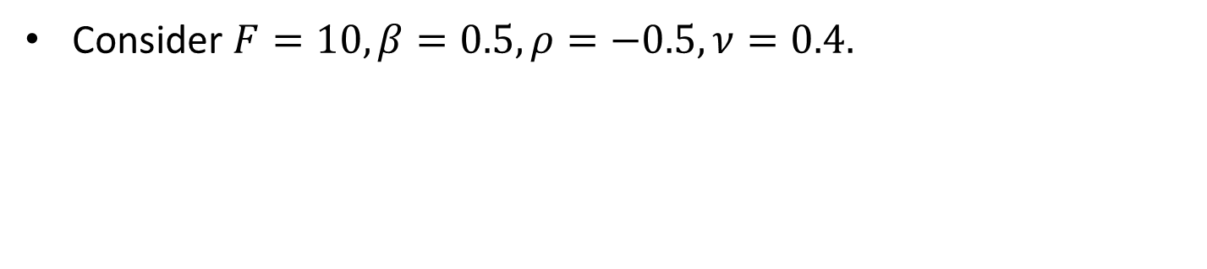

Impact of $α(0)$
Consider $F=10, β=0.5, ρ=−0.5,ν=0.4.$

Slide 14
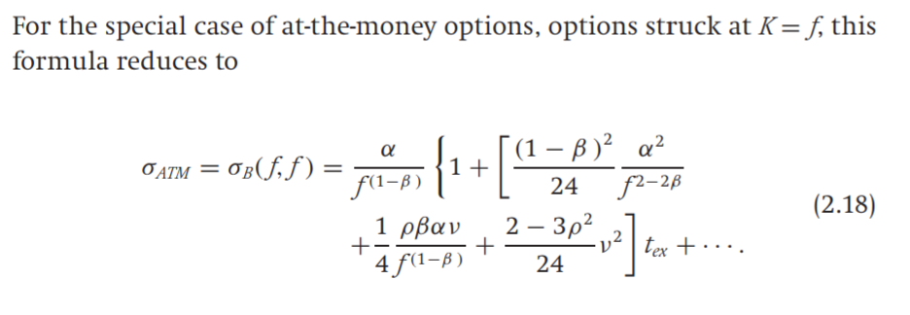
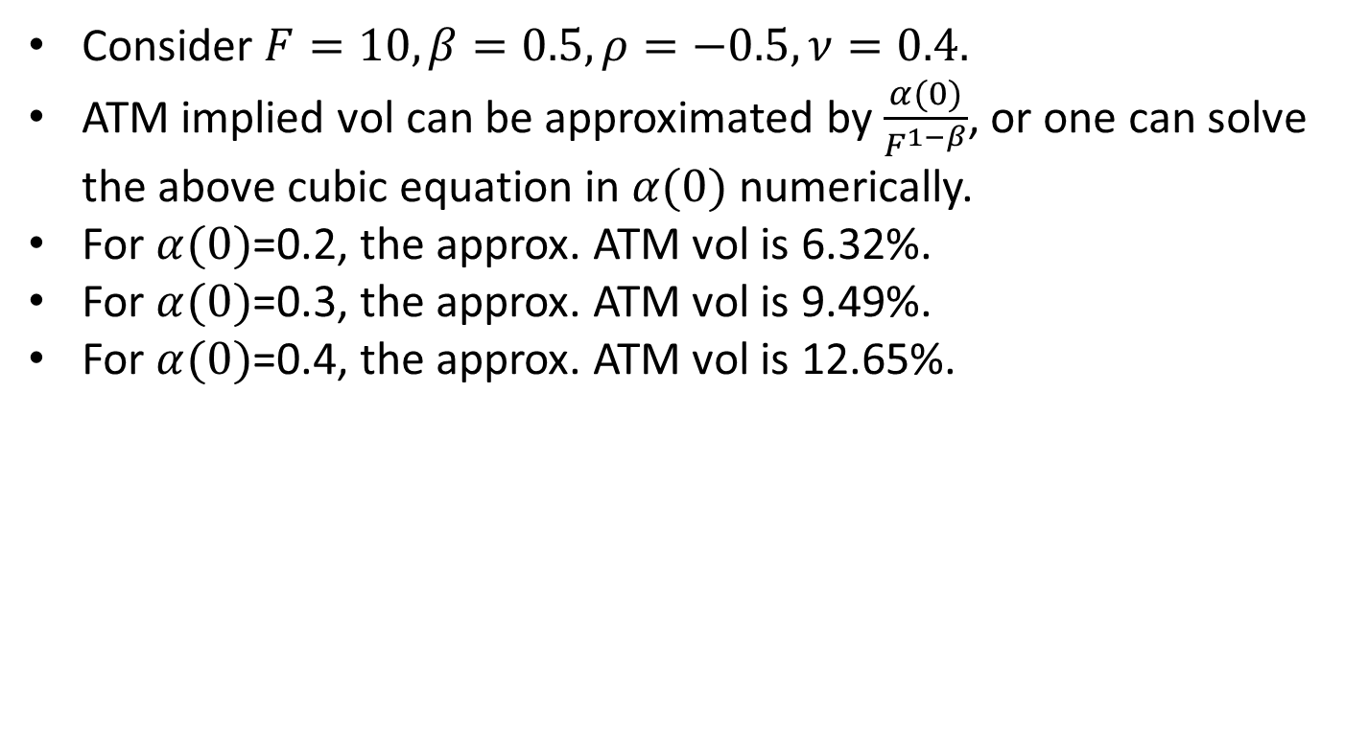
Impact of $α(0)$
Consider $F=10, β=0.5, ρ=−0.5,ν=0.4.$
ATM implied vol can be approximated by $\frac{α(0)}{F^{1−β}}$, or one can solve the above cubic equation in $α(0)$ numerically.
For $α(0)$=0.2, the approx. ATM vol is 6.32%.
For $α(0)$=0.3, the approx. ATM vol is 9.49%.
For $α(0)$=0.4, the approx. ATM vol is 12.65%.

Slide 15
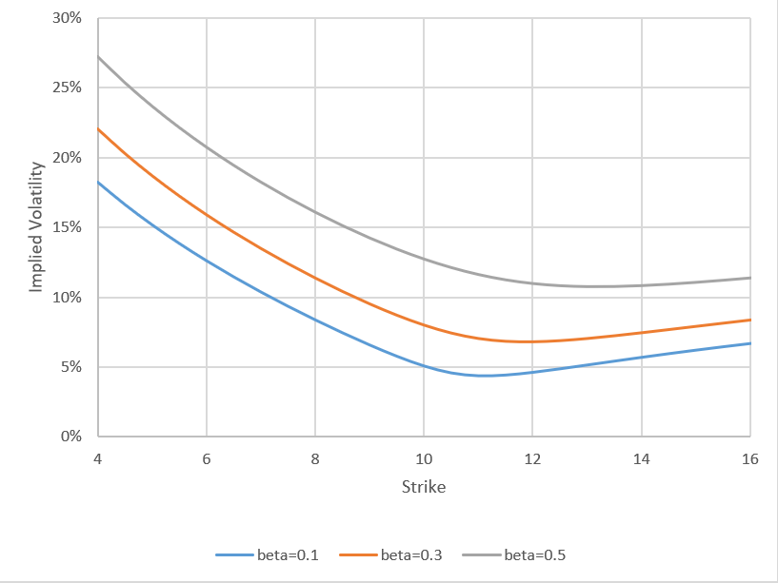
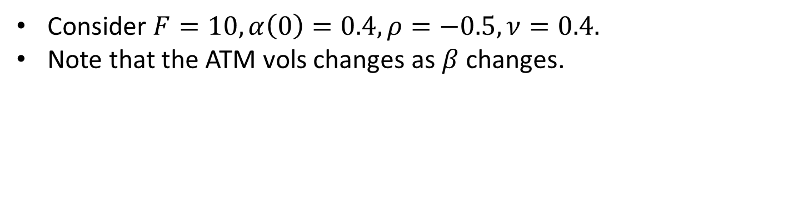

Impact of $β$
Consider $F=10, α\left(0\right)=0.4, ρ=−0.5,ν=0.4.$
Note that the ATM vols changes as $β$changes.

Slide 16
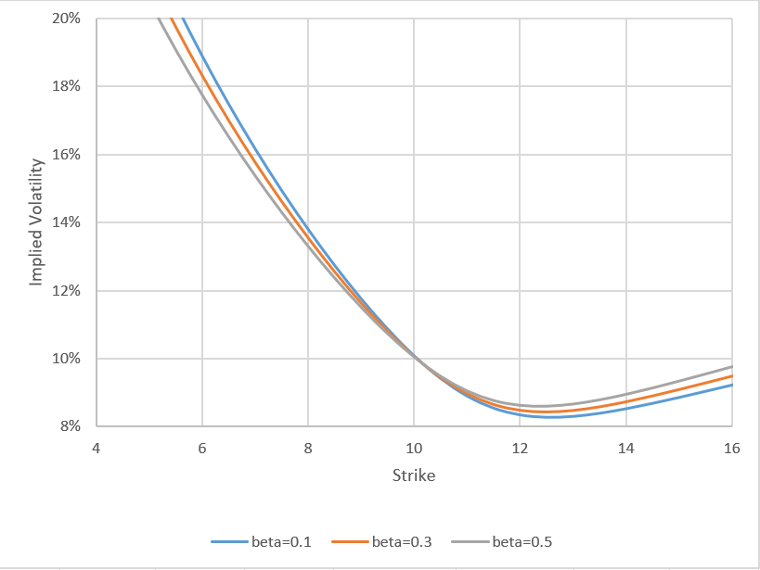
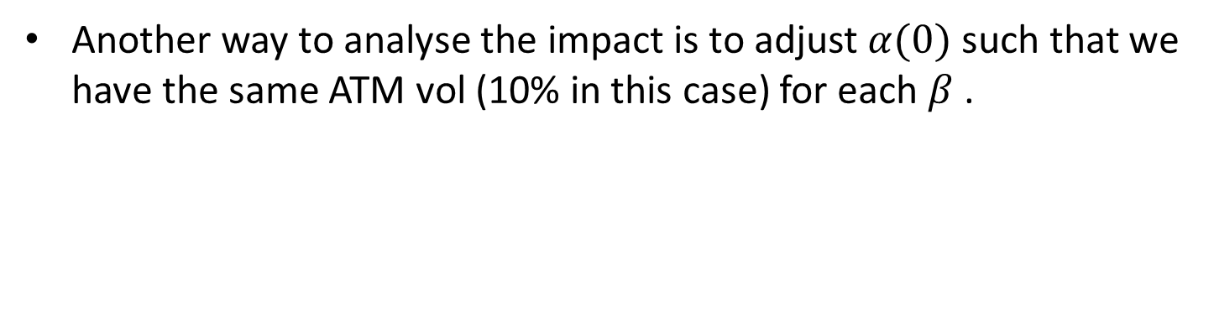
Impact of $β$
Another way to analyse the impact is to adjust $α(0)$such that we have the same ATM vol (10% in this case) for each $β$ .

Slide 17
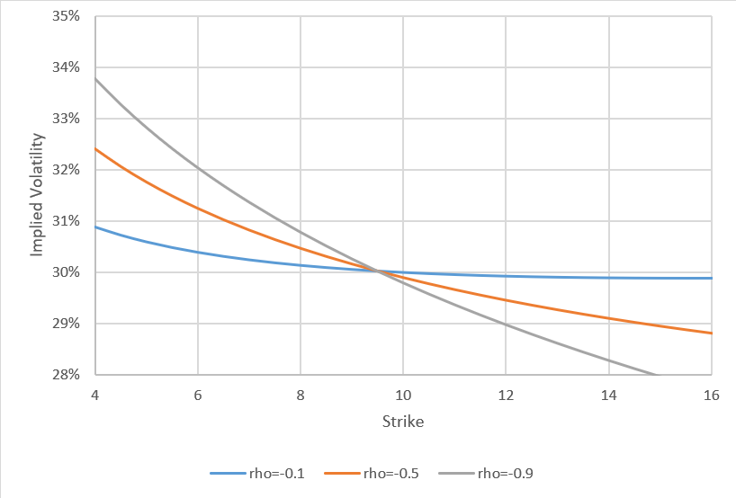
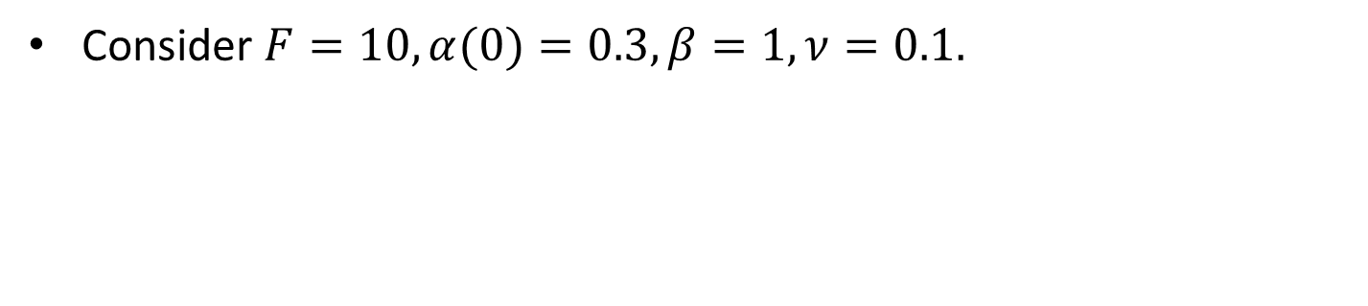

Impact of $ρ$
Consider $F=10, α(0)=0.3, β=1, ν=0.1.$

Slide 18
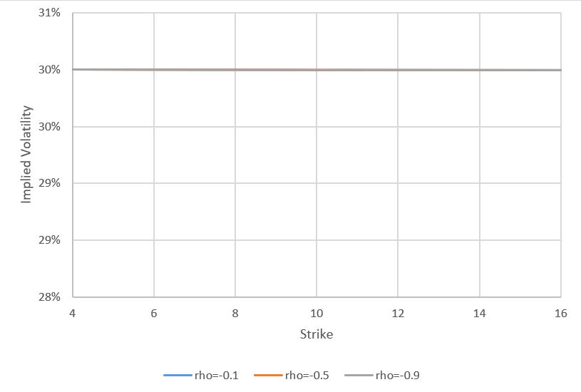
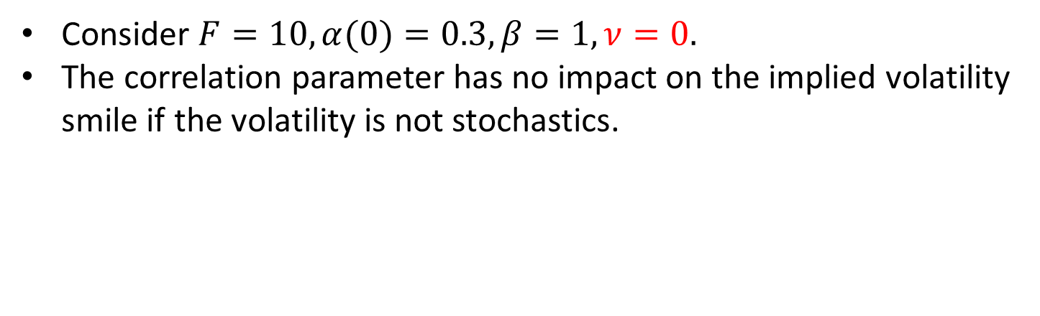
Impact of $ρ$
Consider $F=10, α(0)=0.3, β=1, ν=0.$
The correlation parameter has no impact on the implied volatility smile if the volatility is not stochastics.

Slide 19
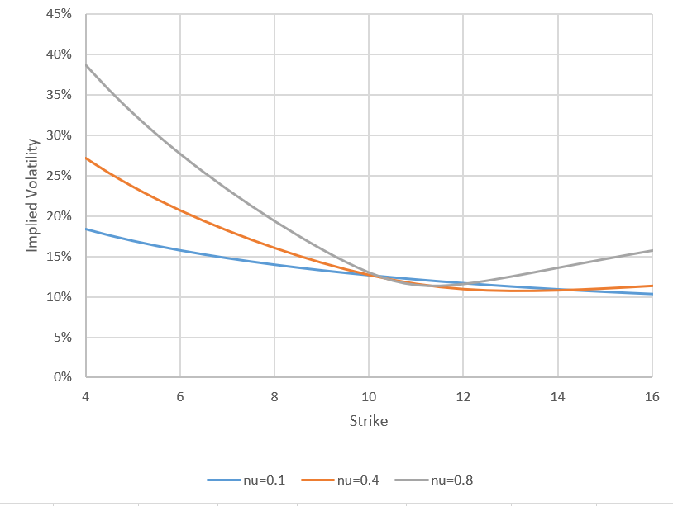
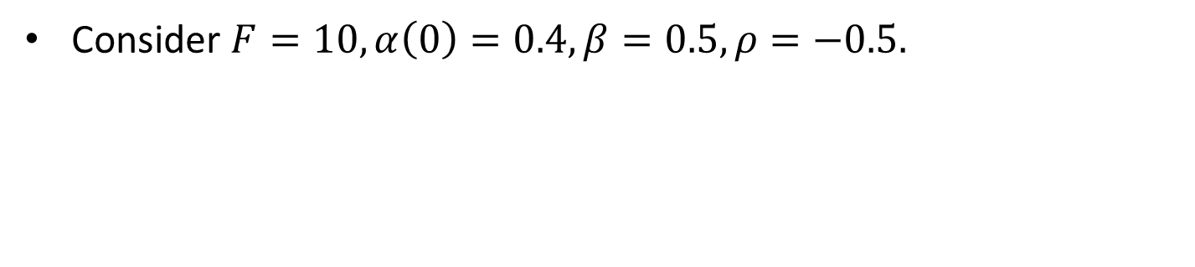

Impact of $ν$
Consider $F=10, α\left(0\right)=0.4, β=0.5, ρ=−0.5.$

Slide 20
SABR
The volatility in the SABR model is drift-less and lognormal.
It may not make sense as we know that volatilities are empirically mean-reverting.
SABR is the simplest extension to Black Scholes that knows about volatility smile.
The strength of the model is having a quite accurate, intuitive and closed-form formula for the implied volatility.

Slide 21
SABR
For most models, the way to calibrate to the volatility smile is the following:
Find a close-form formula or approximation of European option price.
Given a set of model parameters, compute the option prices and then convert the prices to implied volatilities.
Compare the model implied vols to the market implied vols.
Repeat steps 2 and 3 until the result is within tolerance.
Note that step 2 can be computationally quite intensive.
SABR has a closed-form formula for implied vols so that step 2 is not needed.

Slide 22
Barrier options
Barrier options are options that have a payoff contingent on crossing a second strike known as the barrier or trigger.
They are cheaper compared to European options with similar features, offer flexibility in terms of hedging or speculation and higher potential leverage than standard vanilla options.
There are two kinds of barrier option: knock-out options and knock-in options.
Knock-out options are options that expire when the underlying’s spot crosses the specified barrier.
Knock-in options are options that only come into existence if the barrier is crossed by the asset’s price.
The observation of the barrier can be at any time during the option’s life (American style), at maturity only (European style) or partially during the option’s life.

Slide 23
Knock Out (KO) Options
KO options are path-dependent options that are terminated if a specified spot price reaches a specified trigger level at any time between inception and expiry.
In the case the option gets KO, the holder of the option gets zero payout.
If the underlying has never breached the barrier during the life of this option, the option holder essentially holds an option with the same features as a European option of the same strike and expiry.
There are two flavours: up and out and down and out.

Slide 24
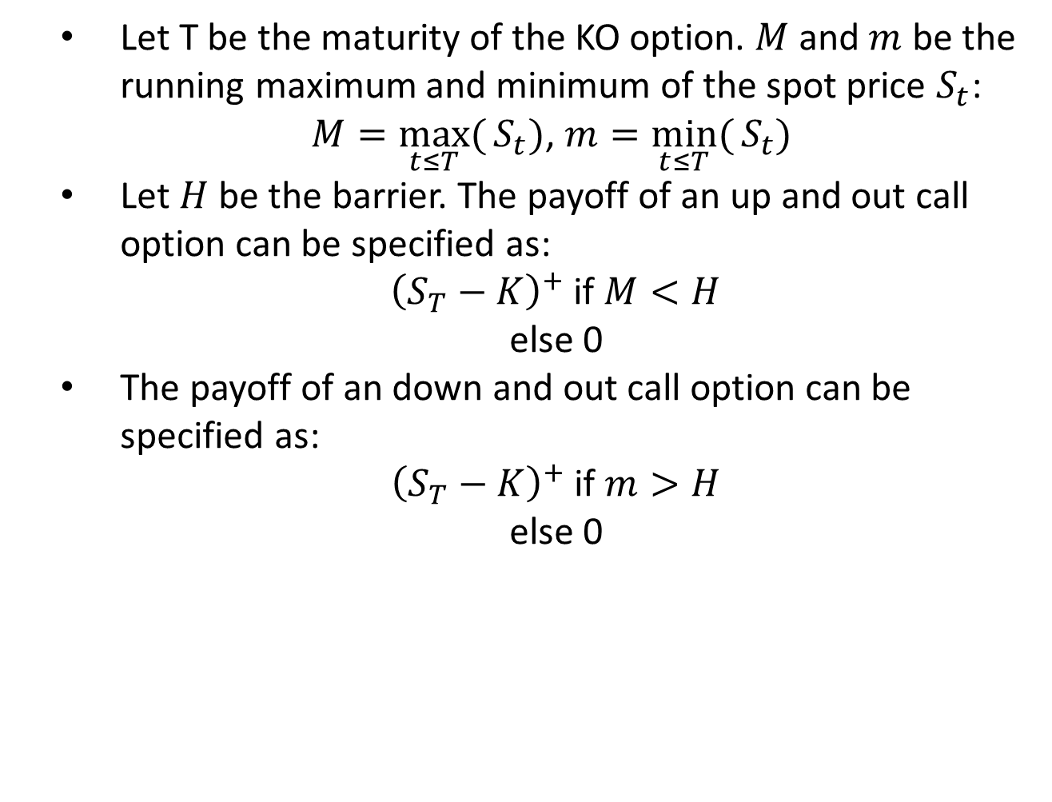
KO Options
Let T be the maturity of the KO option. $M$ and $m$ be the running maximum and minimum of the spot price $S_{t}$:
$M=\max_{t≤T}({S_{t}})$, $m=\min_{t≤T}({S_{t}) }$
Let $H$ be the barrier. The payoff of an up and out call option can be specified as:
${\left(S_{T}−K\right)}^{+}$ if $M<H$
else 0
The payoff of an down and out call option can be specified as:
${\left(S_{T}−K\right)}^{+}$ if $m>H$
else 0

Slide 25
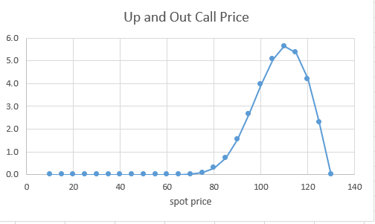
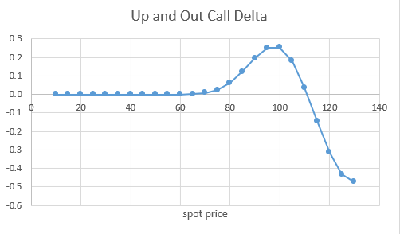
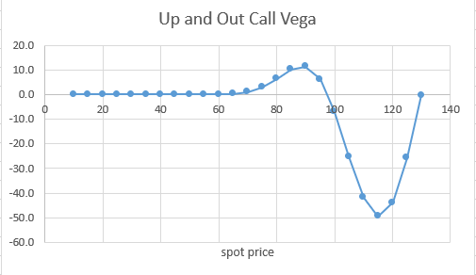
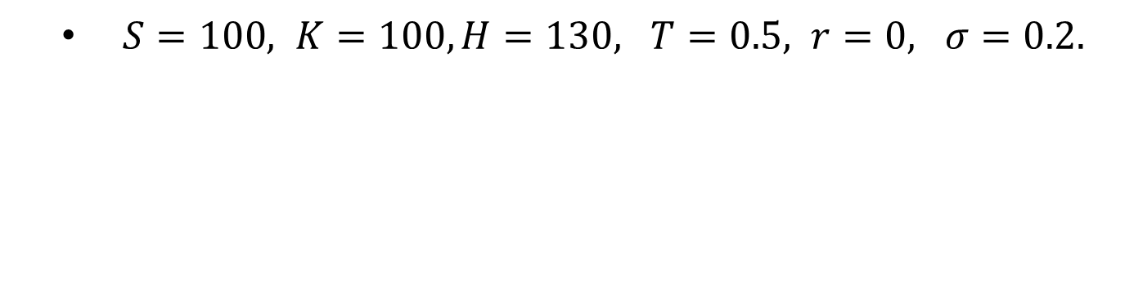
Up and Out Call Option
$S=100, K=100,H=130, T=0.5, r=0, σ=0.2.$

Slide 26
Knock In (KI) Options
KI options are path-dependent options that are activated if a specified spot price reaches a specified trigger level at any time between inception and expiry.
In the case the option gets KI, the option then becomes essentially an European option.
If the underlying has never breached the barrier during the life of this option, the option payout is zero.
There are two flavours: up and out and down and out.

Slide 27
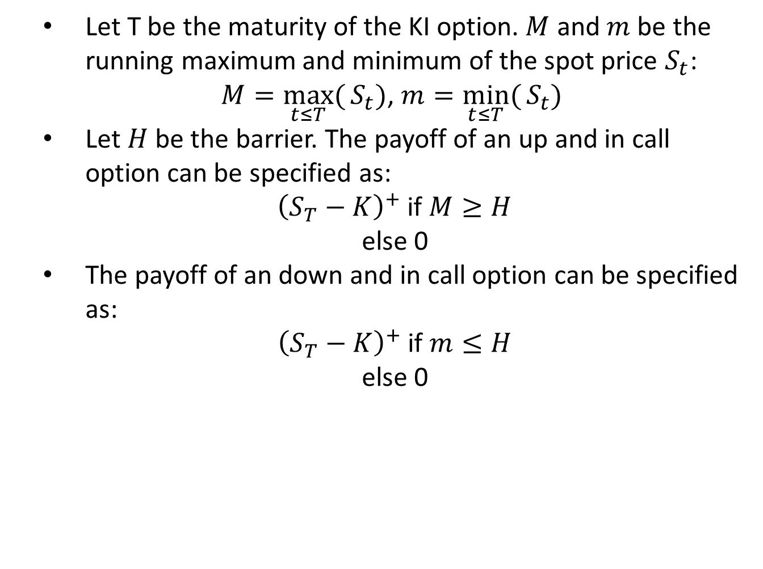
KI Options
Let T be the maturity of the KI option. $M$ and $m$ be the running maximum and minimum of the spot price $S_{t}$:
$M=\max_{t≤T}({S_{t}})$, $m=\min_{t≤T}({S_{t}) }$
Let $H$ be the barrier. The payoff of an up and in call option can be specified as:
${\left(S_{T}−K\right)}^{+}$ if $M≥H$
else 0
The payoff of an down and in call option can be specified as:
${\left(S_{T}−K\right)}^{+}$ if $m≤H$
else 0

Slide 28
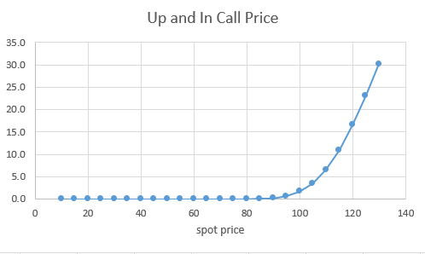
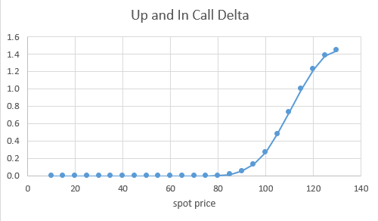
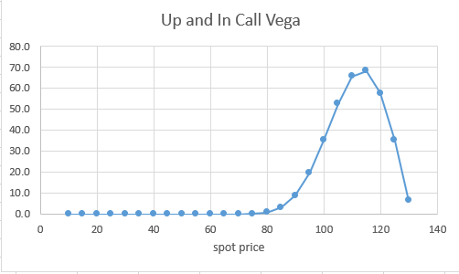
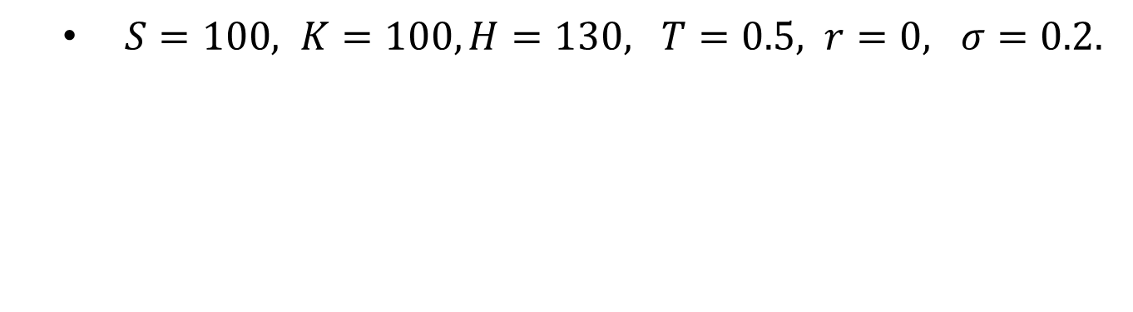
Up and In Call Option
$S=100, K=100, H=130, T=0.5, r=0, σ=0.2.$

Slide 29
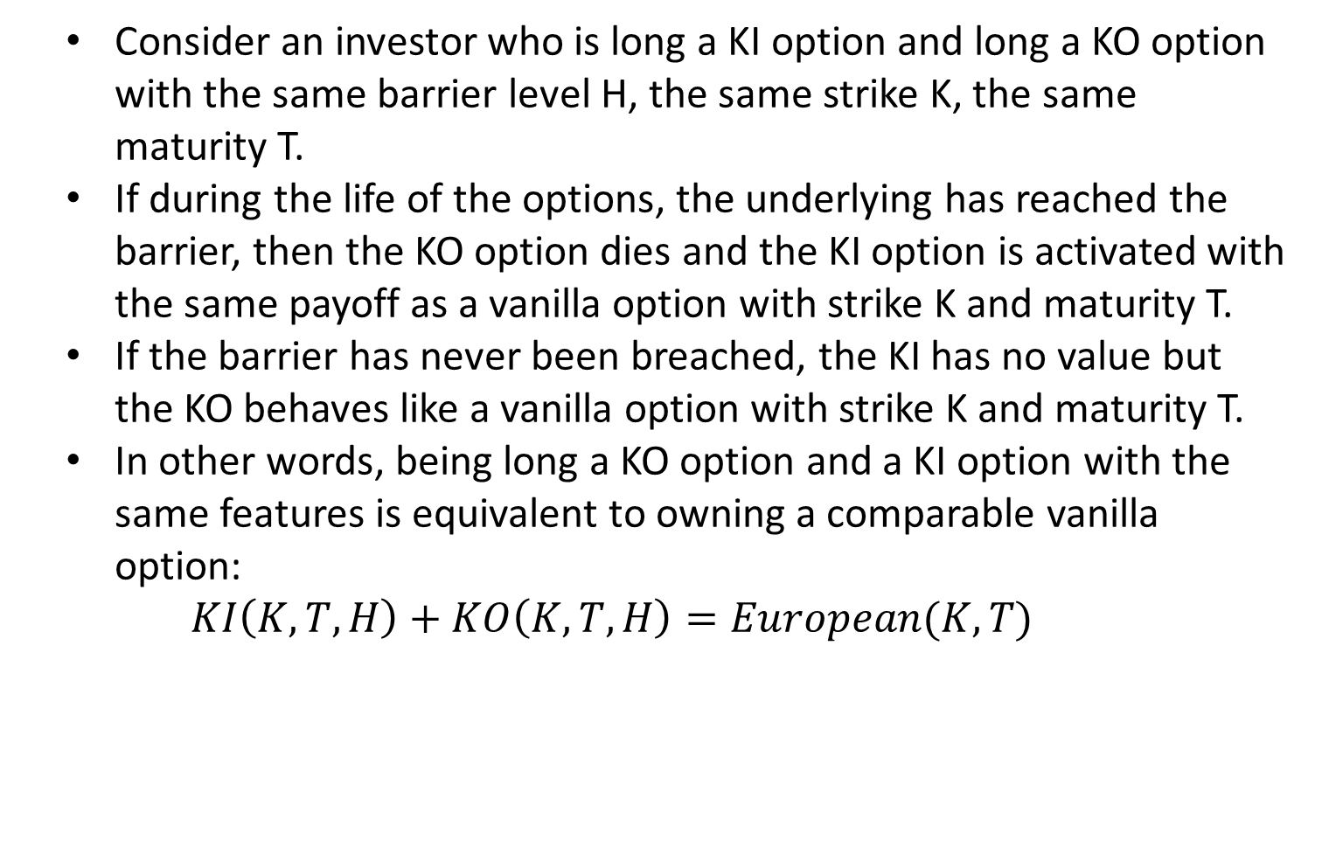
In Out Parity
Consider an investor who is long a KI option and long a KO option with the same barrier level H, the same strike K, the same maturity T.
If during the life of the options, the underlying has reached the barrier, then the KO option dies and the KI option is activated with the same payoff as a vanilla option with strike K and maturity T.
If the barrier has never been breached, the KI has no value but the KO behaves like a vanilla option with strike K and maturity T.
In other words, being long a KO option and a KI option with the same features is equivalent to owning a comparable vanilla option:
$$KI\left(K,T,H\right)+KO\left(K,T,H\right)=European(K,T)$$

Slide 30
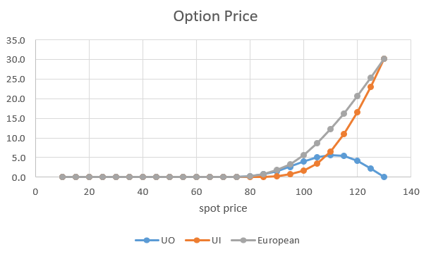
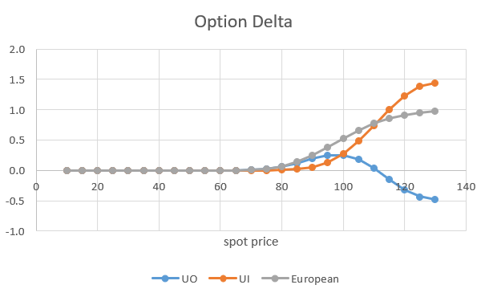
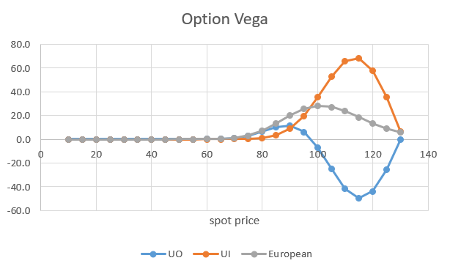
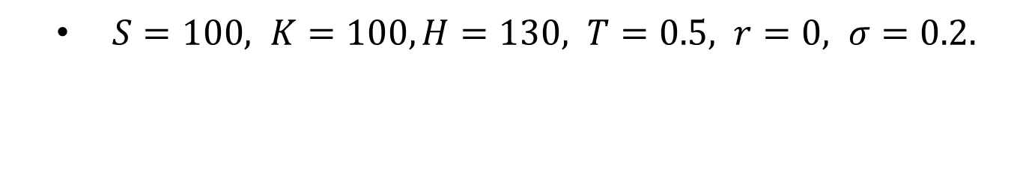
In Out Parity
$S=100, K=100, H=130, T=0.5, r=0, σ=0.2.$

Slide 31
Risk Analysis
Delta of an European call option is bounded from above by one.
Delta of a UI call option can be greater than one when the spot is close to the knock in barrier.
On the other hand, delta of UO call option can be negative when the spot is close to the knock out barrier.
If the barrier is in the region that the option is in the money, then we call those reverse barrier options, e.g.
Up and Out Call – reverse KO call
Up and In Call – reverse KI call
Down and Out Put – reverse KO put
Down and In Put – reverse KI put

Slide 32
Risk Analysis
Vega of an European call option is always positive.
Vega of a UI call option is also always positive as increases in volatility only increases the chance to be KI, hence the value increases.
On the other hand, vega of UO call option can changed sign when the spot is near the barrier. This is because UO call is like a European call if the spot is away from the barrier. That’s the region when the UO call has positive vega.
When the spot is closer to the barrier, increases in volatility has two opposing effects: increase the chance of being KO and increase the value of the option as if it is a standard European option (conditioned on it is not KO).
When spot is very close to the barrier, the KO effect overwhelms the other effect and hence negative vega.

